Slide 1
Introduction to Client-Side Rendering in SharePoint 2013
JSLink
Tesfaye Gari, Sr Systems and Applications Architect
Email: tgari@mtmconsultinggroup.com | tesfaye.gari@gmail.com
Phone: 571-205-5738
Twitter: https://twitter.com/tesfayegari
LinkedIn: https://www.linkedin.com/in/tesfayegari/

Slide 2
About Me
Tesfaye Gari is a Sr System and Application Architect with American Chemistry Council member CHEMTREC in Falls Church, VA. He has a masters degree in Computer Science, Computer Engineering, bachelor in Electrical and Computer Engineering. Tesfaye has over 14 years' experience in the IT industry implementing products and technologies. He has held positions ranging from system Architect, systems administrator to developer to trainer. Tesfaye has been working with SharePoint since WSS 3.0. He is also known for training end users and site collection administrators, Jr Developers. Recently he started a startup company called MTM IT Consulting inc based in VA

Slide 3
Agenda
Introduction to CSR
Advantages and Disadvantages of Client-Side Rendering
How to use JSLink
Examples and Demos
SharePoint List Accordion (Custom Solution) using JSLink
Debugging and Tips

Slide 4
Introduction to CSR
Client Site Rendering is simply a term for when the data is transformed using the client rather than the server.
This means using client-side technologies, such as HTML and JavaScript.
It allows us to style SharePoint elements using JavaScript, rather than having to write XSLT.
You can use it to style complete List Views, Fields, Search Results and more.
This makes it a lot simpler and more intuitive, especially for web developers who haven’t used SharePoint before.
When talking about Client Side Rendering in SharePoint, there’s really 2 mechanisms; search Display Templates, and JSLink. From MSDN (http://msdn.microsoft.com/en-us/library/jj945138.aspx):
Notes:
One of the best new features for SharePoint branders is Client Side Rendering.
In today's session, I’ll go through what it is, how Client Side Rendering (CSR) can be used, and some tips I’ve found for debugging and developing it.
custom field types provide an incredibly powerful mechanism for creating fields with a custom behavior and look and feel, they also have some significant downsides. The main drawback of custom field types is that they have to be installed by using a farm solution. This means that they can only be used in on-premises SharePoint environments.

Slide 5
Introduction …
Display templates in SharePoint Server 2013 are templates used in Web Parts that use search technology.
Display templates allow us to completely transform the way search results look, which gives an endless possibility of what they can be used for.
A common example would be in the use of Blog rollup. Because the results are based off of search, it allows us roll up results from multiple site collections, and even from other farms, or non-SharePoint sources.
JSLink on the other hand is a property available on many SharePoint objects, including Fields, Lists, Views, and Content Types.
In its simplest form, the JSLink property simply adds a JavaScript file to the page. Depending on the JavaScript, this could then do anything – either related to the object of which it was attached, or something completely irrelevant if desired.
Notes:
One of the best new features for SharePoint branders is Client Side Rendering.
In today's session, I’ll go through what it is, how Client Side Rendering (CSR) can be used, and some tips I’ve found for debugging and developing it.
custom field types provide an incredibly powerful mechanism for creating fields with a custom behavior and look and feel, they also have some significant downsides. The main drawback of custom field types is that they have to be installed by using a farm solution. This means that they can only be used in on-premises SharePoint environments.
In SharePoint 2013, Microsoft has introduced a new way to customize fields that can be used in both on-premises environments and cloud-based environments such as SharePoint Online 2013. The way fields can be customized by using a sandboxed solution or a SharePoint app is by using the new JSLink property that is available on SPField objects. It’s not just fields that can be adjusted by using JSLink. The following objects can use the JSLink property:

Slide 6
Advantages of Client-Side Rendering
There are a few advantages of using Client Side Rendering VS XSL.
  Performance – Because the rendering is done Client Side, the burden is taken away from the server. This means that the pages can load faster when using CSR.
  Ease of Development – Let’s face it: nobody really likes XSL – especially in SharePoint. All web developers should be familiar with JavaScript, which makes Client Side Rendering a lot easier to pick up. This should mean reduced development time, and less bugs.
  Flexibility – You can chose to overwrite just a particular field, the header, footer, or the entire view. You can also extend it; you’re not limited to using just SharePoint JavaScript to process the list, you can use the whole power of JavaScript, as well as any plugins such as jQuery.
Notes:
One of the best new features for SharePoint branders is Client Side Rendering.
In today's session, I’ll go through what it is, how Client Side Rendering (CSR) can be used, and some tips I’ve found for debugging and developing it.

Slide 7
Disadvantages of Client-Side Rendering
Having mentioned the advantages, it’s only fair to mention the disadvantages:
  Compatibility – As it’s rendering on the client browser, you have less control of what’s happening. If the client does not support a function you use, then that user will get a different experience to other users. With XSL, this was not the case, as the server dealt with it, ensuring everyone got the same HTML back.
  SEO – This is only really relevant for public facing sites, however, rendering everything with JS is a bad idea for public site SEO. Crawlers are less likely to understand it, and may not display that content in search.
  Performance – Although this was listed as an advantage, it is also a disadvantage. If the client computers are particularly old, or under spec’d, complicated JavaScript could make the browser hang, or in particularly bad cases, crash completely.
Notes:
One of the best new features for SharePoint branders is Client Side Rendering.
In today's session, I’ll go through what it is, how Client Side Rendering (CSR) can be used, and some tips I’ve found for debugging and developing it.

Slide 8
How to use JSLink
Firstly, I’d recommend having a look at Client-side rendering (JS Link) code samples
The steps are:
  Create your List (Including Views)
  Create your JavaScript file
  Upload your Script to a Library
  Set the JSLink property of your Web Part to point to the JavaScript file uploaded
Sounds easy enough, but there are a few details to sort out to get everything synced up. Additional details follows
Notes:
One of the best new features for SharePoint branders is Client Side Rendering.
In today's session, I’ll go through what it is, how Client Side Rendering (CSR) can be used, and some tips I’ve found for debugging and developing it.

Slide 9
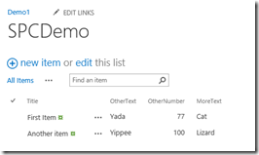
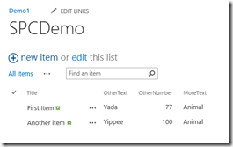
Example 1: Override a specific field in a view
We start with a standard view (AllItems) that shows text fields, and then use the JS Link functionality to override a single column – displaying different text than came with the view. We are replacing whatever the ‘MoreText’ column contained with the word ‘Animal’.
Before:
After:
Notes:
First Example

Slide 10
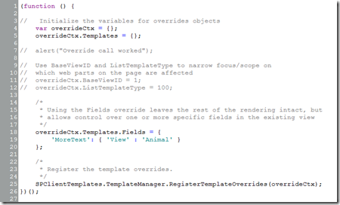
As the notes in the sample script mention, the Fields override works specifically with individual fields. You can specify a single field, or multiple fields. For each field (column) override, you need to identify the field being overridden and the replacement value.
When identifying the field name, take note that you need to use the internal name for the column, which may not be the same name that is displayed.
Notes:
// anonymous self-executing function to setup JSLink templates on page load..
(function () {……
As the notes in the sample script mention, the Fields override works specifically with individual fields. You can specify a single field, or multiple fields. For each field (column) override, you need to identify the field being overridden and the replacement value.
When identifying the field name, take note that you need to use the internal name for the column, which may not be the same name that is displayed.
The ‘View’ component of the command is in reference to the type of template being overridden – in our case the view. There are also options for the NewItem, EditItem and DisplayItem forms, but we won’t cover them today.
The last piece of the command for each field is the override value for the field. This can be a static value – as in the first example – a variable, or HTML and the value, allowing you to style the value. You can also call a function within the script to do more complicated logic – such as conditional formatting – but for the field.

Slide 11
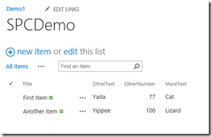
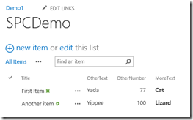
Example 2: Displays the true value of the MoreText field, but formats it (bold) by wrapping it in an HTML tag.
Before:
After:

Slide 12


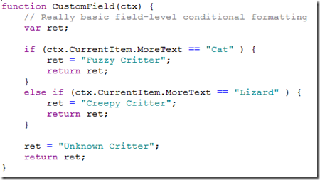
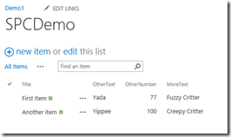
Example 3: Calls a function that formats the value that overrides the field data
Before:
After:
Notes:
Example 4: Uses a different override. This example uses the Item override instead of the Field override. Using the Item completely overrides the web part and requires the Header and Footer overrides as well. In the example here, the data is displayed in an HTML list where the open tag is in the header and the closing tag is in the footer. Each item is then an item in the list.

Slide 13
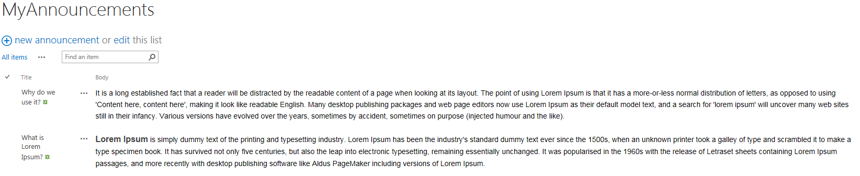
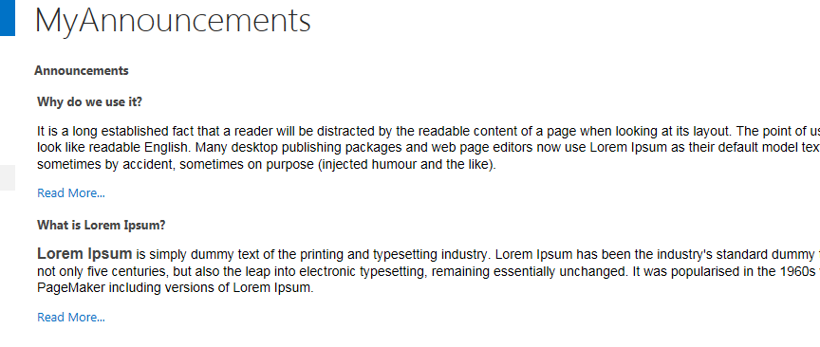
Example 4: Styling Announcements using JS Link
As a demonstration of what can be achieved with the JS Link, I’m going to step through Styling Announcements list, as pictured below. Before:
After:
Notes:
One of the best new features for SharePoint branders is Client Side Rendering.
In today's session, I’ll go through what it is, how Client Side Rendering (CSR) can be used, and some tips I’ve found for debugging and developing it.

Slide 14
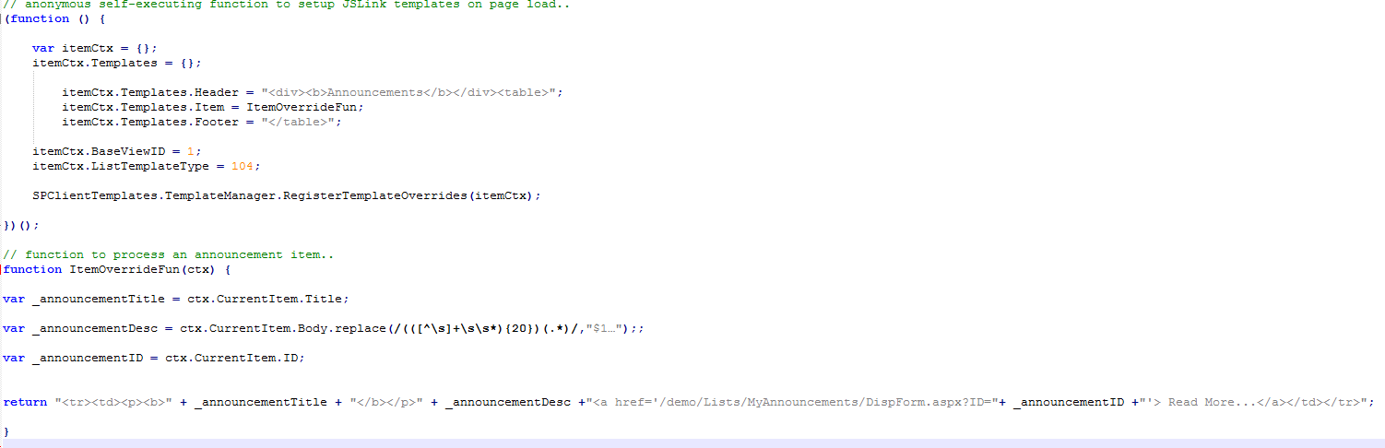
Code Demo
Demo
For the override, I’ve chosen to use a function. I find this a lot easier to read, and also to debug when it doesn’t behave. For this, I’ve added the following code:
Notes:
One of the best new features for SharePoint branders is Client Side Rendering.
In today's session, I’ll go through what it is, how Client Side Rendering (CSR) can be used, and some tips I’ve found for debugging and developing it.

Slide 15
Set the JSLink property of a List View Web Part
Edit Current Page.
Selected edit web part for View form.
Go to Miscellaneous > JS Link property.
Add the reference of JSLink file:
If you have placed your JS inside SiteAssets library of some CHILD site, you should use ~site/SiteAssets/<Your JSLink File Name> url.
If you have placed your JS inside SiteAssets library of root site of site collection, you should use ~sitecollection/SiteAssets//<Your JSLink File Name> url.
Reference
https://social.technet.microsoft.com/wiki/contents/articles/37684.sharepoint-2013-jslink-client-side-rendering.aspx
Notes:
One of the best new features for SharePoint branders is Client Side Rendering.
In today's session, I’ll go through what it is, how Client Side Rendering (CSR) can be used, and some tips I’ve found for debugging and developing it.

Slide 16
Debugging the JavaScript
As you work with the JSLink and Client Side Rendering, sooner or later you’re going to find something isn’t working. Working out what’s happening can seem a little tricky to begin with, so here’s a few tips for debugging the script.
Check the Script actually exists
This one sounds stupid, but the first thing to do is check that the script exists. Make sure that when you view the source of you page, you can see the script tag which points to your file. Also make sure that. As I mentioned, when I left out the “~sitecollection” token from the JS Link property, my script just wasn’t on the page, so give this a double check first.
Alerts and Logs
To quickly make sure that your override is getting run, you can throw an alert in. I’d tend to avoid alerts for this sort of work however. Imagine you have a list with 100 items in, and you put a couple of alerts in the override function. This is going result in hundreds of alerts, and a lot of annoyance. Instead, I’d use console.log to output the messages to the developer toolbar. This is a lot cleaner, however has the disadvantage of not pausing the script while you look at the values.
Notes:
One of the best new features for SharePoint branders is Client Side Rendering.
In today's session, I’ll go through what it is, how Client Side Rendering (CSR) can be used, and some tips I’ve found for debugging and developing it.

Slide 17
Debugging the JavaScript …
Debugger
This is my personal favorite way of debugging any JavaScript. It’s really easy to use, and can give a lot more information than an alert. Debugger adds a breakpoint to your script, which means you have a chance to inspect the objects in their current state. If you’re using Chrome, and have the Developer Toolbar open when you load the page, it will automatically stop at the debugger statement, giving you a chances to investigate any issues.
DEMO debugging
Notes:
One of the best new features for SharePoint branders is Client Side Rendering.
In today's session, I’ll go through what it is, how Client Side Rendering (CSR) can be used, and some tips I’ve found for debugging and developing it.

Slide 18
Notes:
Be sure to take a look at the HTML that is produced by the page once you have your CSR in place. Some approaches in the CSR may not jive well with the existing page code. You want to avoid conflicting tags, etc.
JS Link override will not work if the form has been edited in SPD.

Slide 19
The End ….
Thank you!
Tesfaye Gari, Sr Systems and Applications Architect
Email: tgari@mtmconsultinggroup.com | tesfaye.gari@gmail.com
Phone: 571-205-5738
Twitter: https://twitter.com/tesfayegari
LinkedIn: https://www.linkedin.com/in/tesfayegari/

